Slide 1




Slide 2
What is Zigbee?
ZigBee is a new wireless technology
Technological Standard Created for Control and Sensor Networks
Based on the IEEE 802.15.4 Standard
Created by the ZigBee Alliance
Philips, Motorola, Intel, HP are all members of the allience.

Slide 3
Zigbee
Designed for low power consumption allowing batteries to essentially last for ever
ZigBee makes possible completely networked homes where all devices are able to communicate and be controlled by a single unit
It provides network,security and application support services operating on the top of IEEE

Slide 4










IEEE 802.15.4 & ZigBee
Application
Customer
API
Security
32- / 64- / 128-bit encryption
ZigBee Alliance
Network
Star / Mesh / Cluster-Tree
MAC
PHY
868MHz / 915MHz / 2.4GHz
IEEE 802.15.4
Silicon
Stack
App

Slide 5
Architecture
Layered architecture
These layers facilitate the features that make ZigBee very attractive:
low cost
easy implementation
reliable data transfer
short-range operations
very low power consumption
adequate security features

Slide 6
Architecture
Layers
1.Network and Application Support layer 2.Physical (PHY) layer
3.Media access control (MAC) layer

Slide 7
Zigbee Device Types
There are three different ZigBee device types that operate on the layers in any self-organizing application network
Zigbee Coordinator node
Full Function Device (FFD)
Reduced Function Device(RFD)

Slide 8
1.Zigbee Coordinator Node
It is the root of network tree and a bridge to other network
Able to store information about the network
Only one ZCN for a network
It act as a repositary for other security keys

Slide 9
2.The full Function Device
An intermediatory router transmitting data from other devices
Needs lesser memory than Zigbee coordinator node
Lesser manufacturing cost
Can operate on all topologies
Also act as a coordinator

Slide 10
3.The Reduced Function Device
Device capable of talking in the network
It cannot relay data from other devices
Less memory
Cheaper than FFD
It talks only to the n/w coordinator

Slide 11
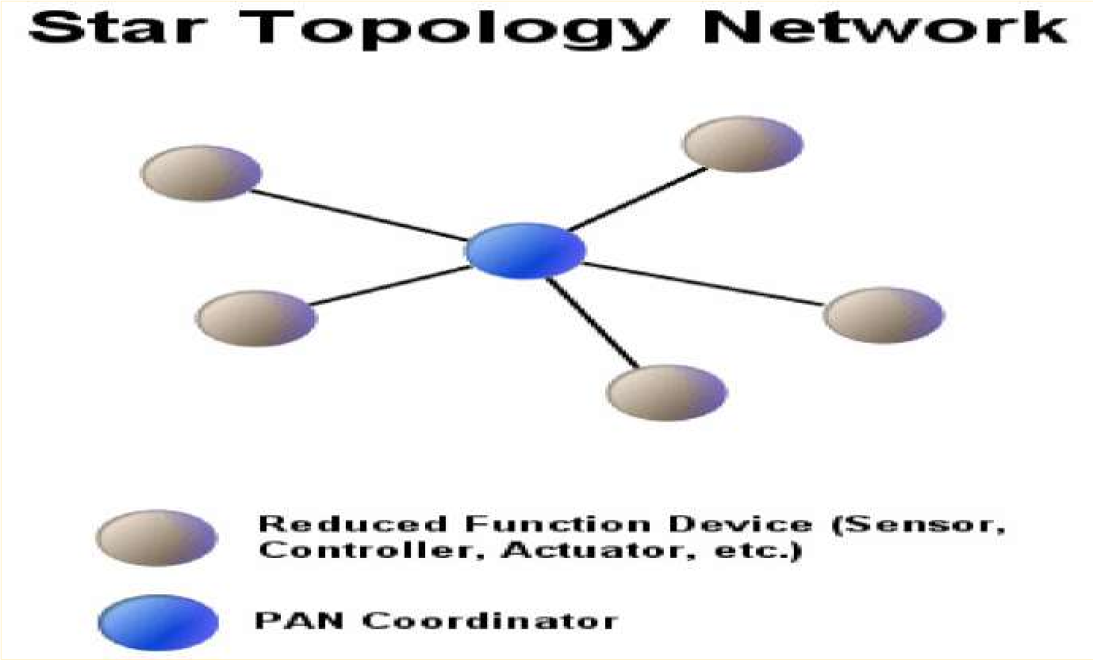
Network Topologies
1.Star Topology

Slide 12
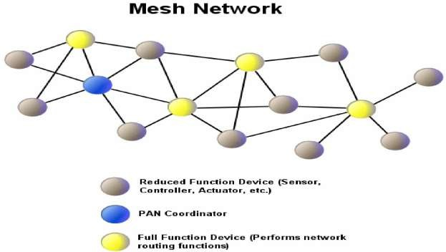
Network Topologies(cont…)
2. Peer-to-Peer Topology

Slide 13

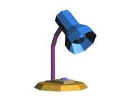
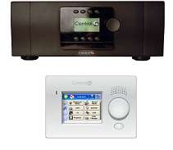
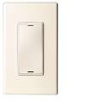
ZigBee Mesh Networking

Slide 14
ZigBee Mesh Networking

Slide 15

ZigBee Mesh Networking

Slide 16
ZigBee Mesh Networking
\

Slide 17

ZigBee Mesh Networking

Slide 18
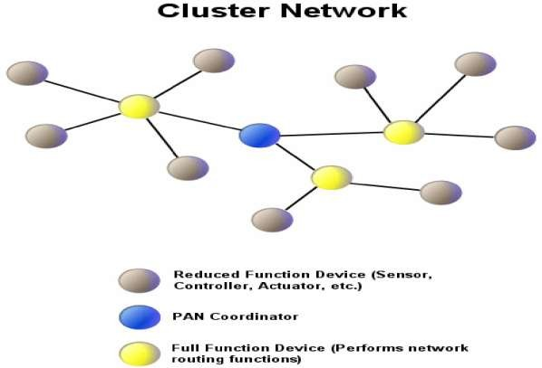
Network Topologies(cont...)
3.Cluster Network

Slide 19
Characteristics
Low power consumption with battery life ranging from months to years
High density of nodes per network
Low cost
Simple implementation
Low data rate
Small packet devices

Slide 20
Applications
The ZigBee Alliance targets applications Across consumer, commercial, industrial and government markets worldwide
Home networking
Industrial control and management

Slide 21
Conclusion
In future all devices and their controls will be based on this standard.
Since Wireless personal Area Networking applies not only to household devices, but also to individualised office automation applications, ZigBee is here to stay. It is more than likely the basis of future home- networking solutions………

